Slide 1

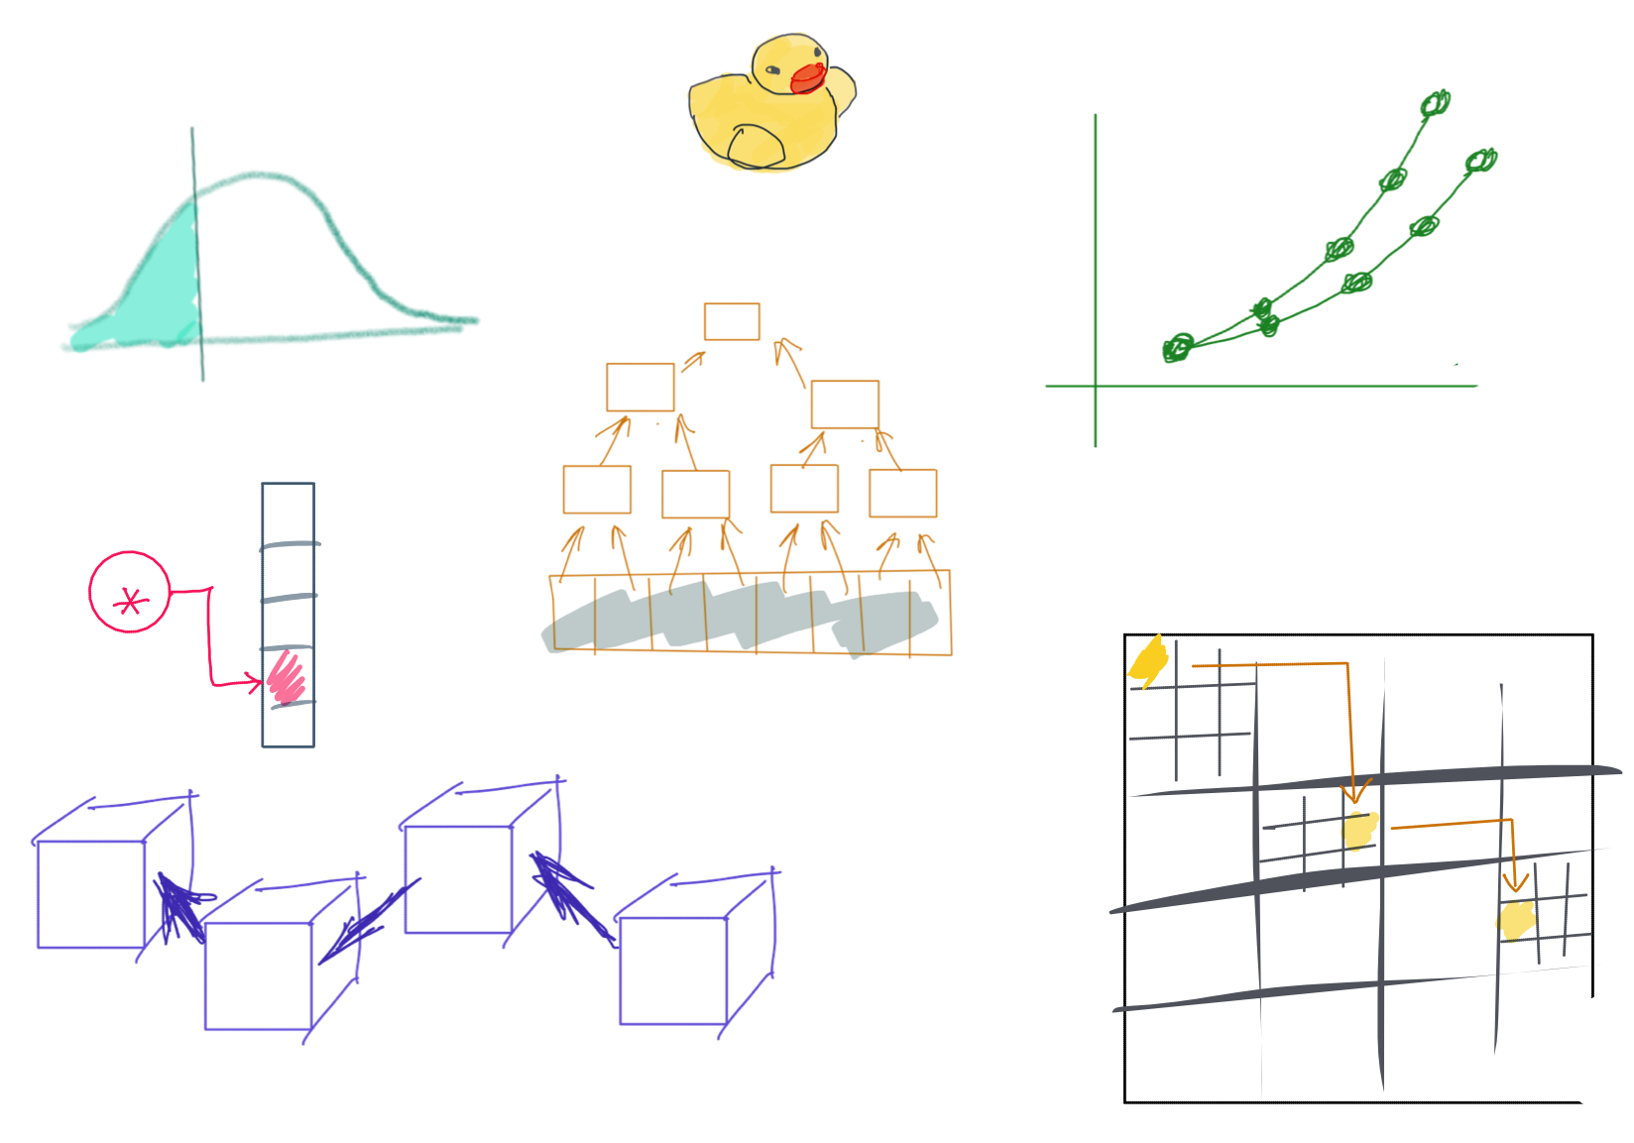

Slide 2
CSS342 Data Structures, Algorithms, and Discrete Mathematics (I)

Slide 3
Where are we at now?
ADT (array vs list)
One-dimensional ADT
ArrayList
Stack
LinkedList
Queue
Hash table
Recursion
Search Problem
Sorting
Binary tree
multi-dimensional ADT

Slide 4
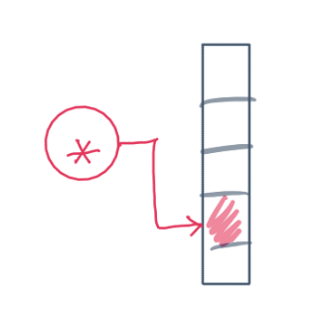
^{6th} Week Schedule
Homework 3 Review (Wed)
ADT hashtable (Wed)
Midterm review (Wed)
Midterm (Friday, 5:45pm, 1-1.5 hrs)
No lecture after midterm on Friday

Slide 5
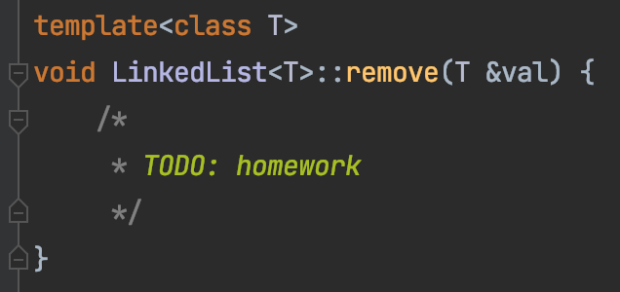
Homework 3 Review

Slide 6
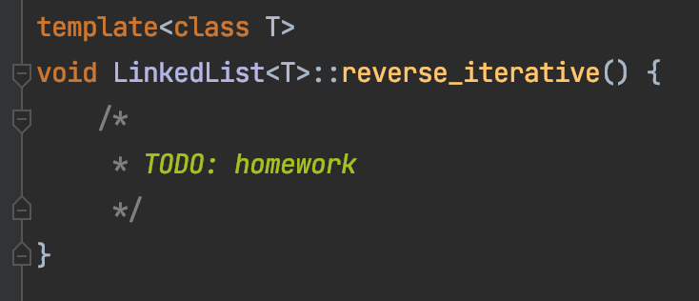
Homework 3 Review

Slide 7
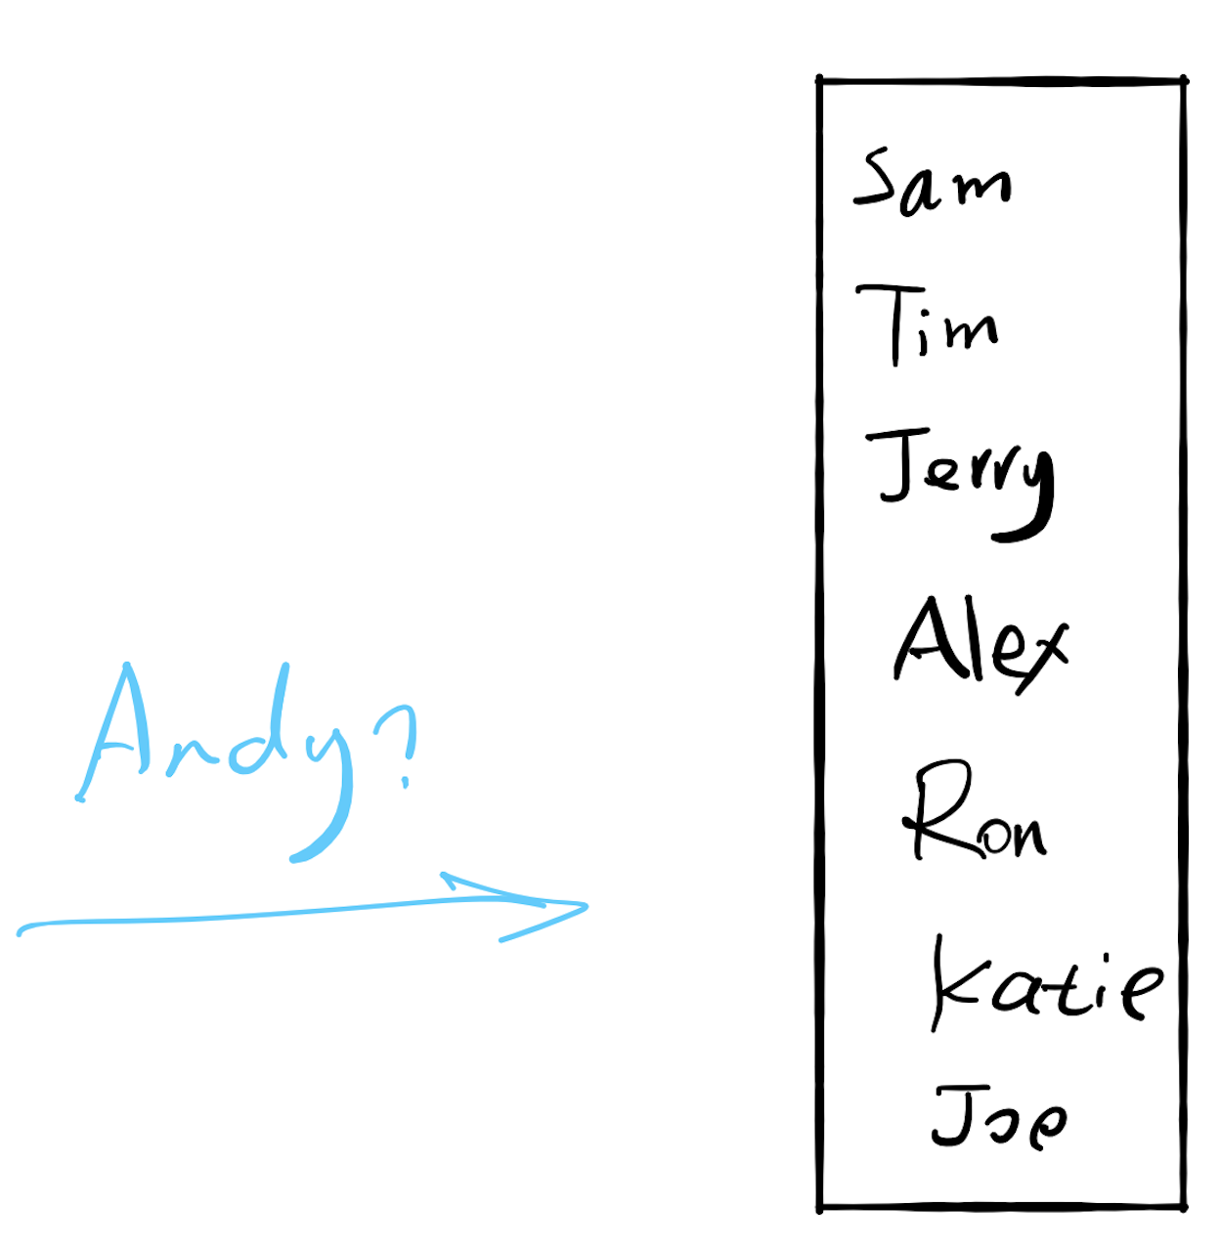

17.1 Search

Slide 8
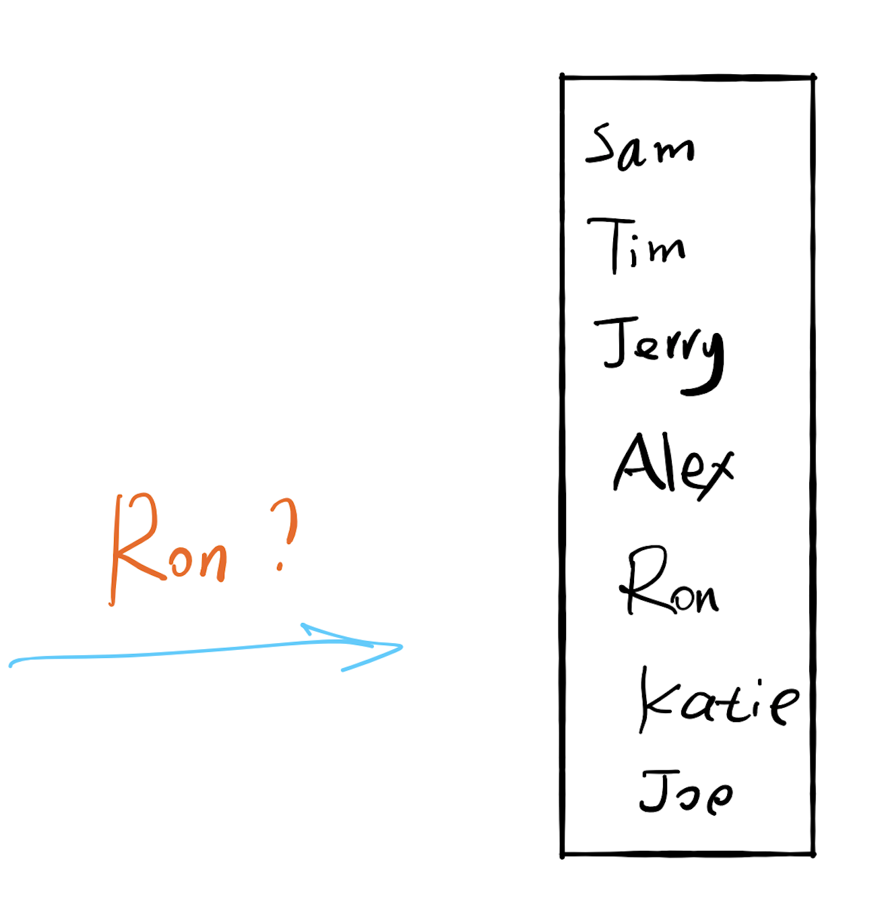

Slide 9
If there are 100 users
Each comparison takes 1 seconds
Worst case: 100 seconds (1.7 minutes)

Slide 10
If there are 10,000 users
Each comparison takes 1 seconds
Worst case: 10,000 seconds (2.8 hours)

Slide 11
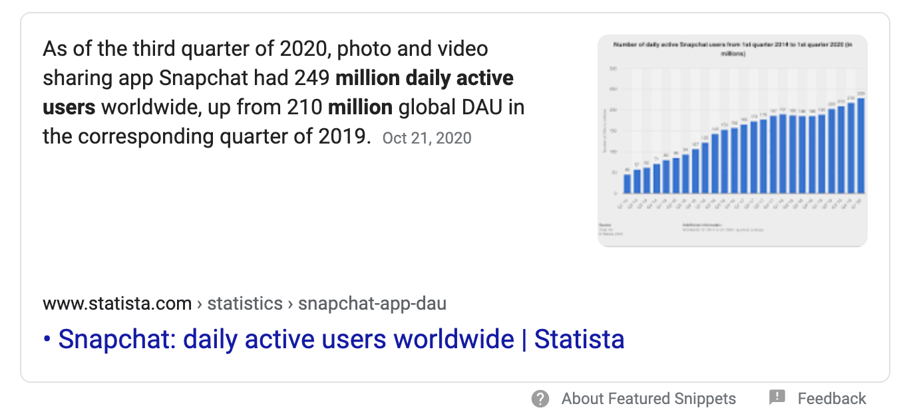
If there are 249 million users
Each comparison takes 1 seconds
Worst case: How long?

Slide 12
If there are 10,000 users
Worst case: 10,000 seconds (2.8 hours)
Can we do better?
Sort

Slide 13
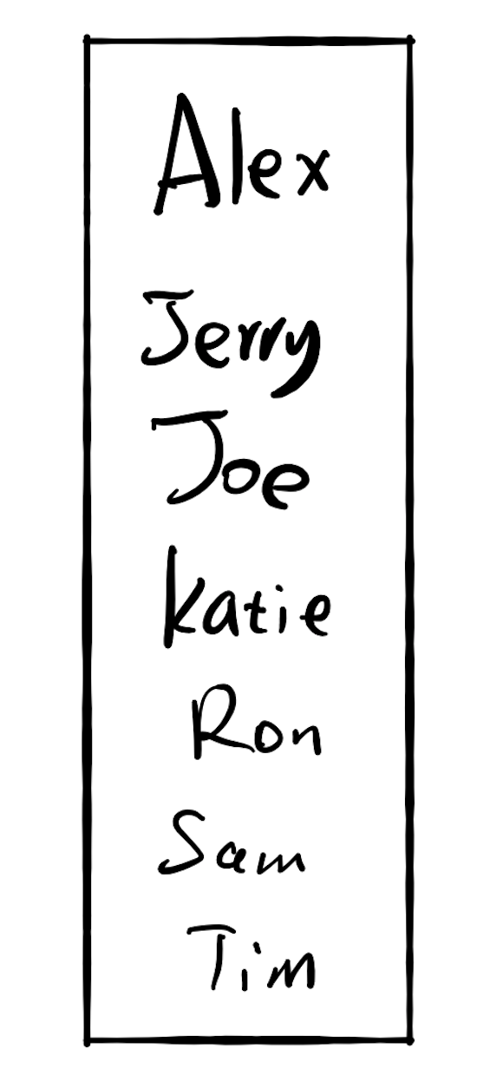
If there are 10,000 users
Worst case: 10,000 seconds (2.8 hours)
Worst case: 13.3 seconds

Slide 14
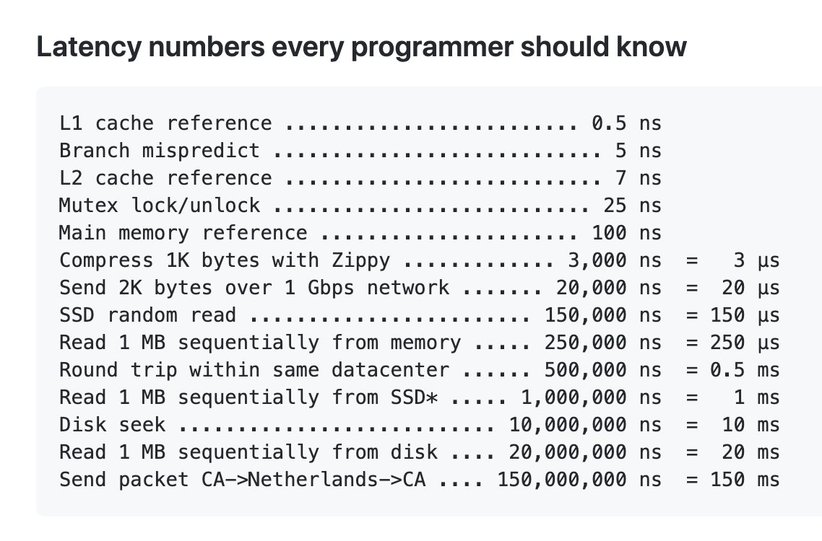
17.2 Insertion
If there are 10,000 users
Each memory ops takes 2 seconds
Because memory ops is slow
https://gist.github.com/hellerbarde/2843375

Slide 15
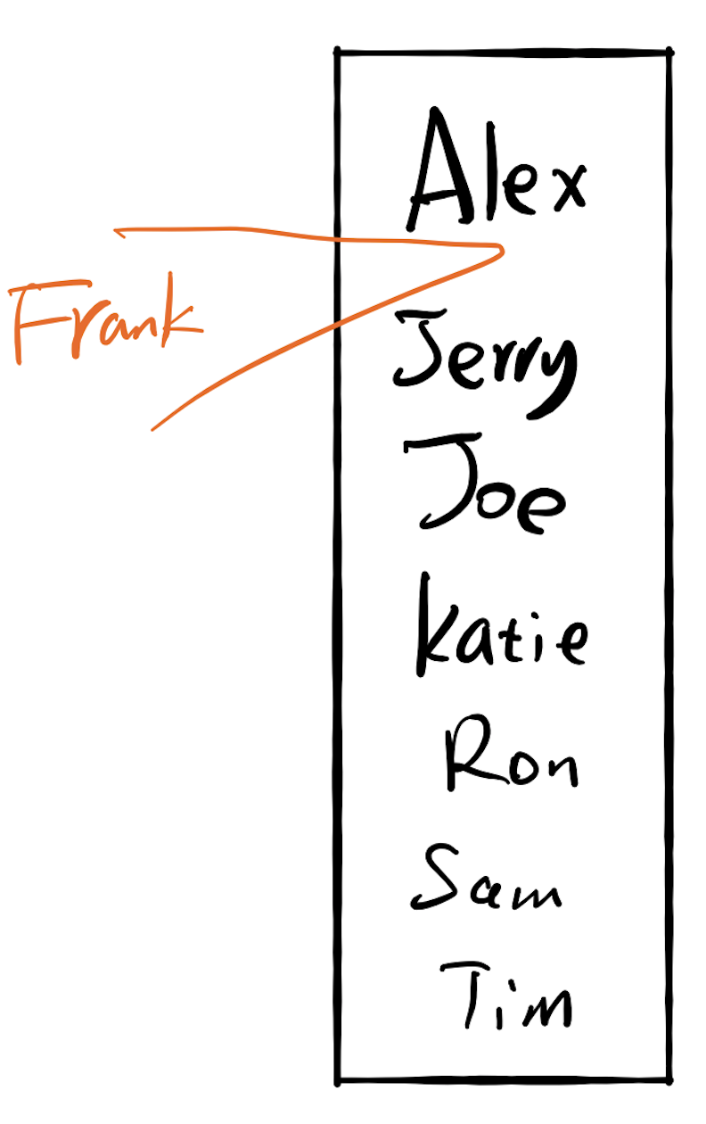
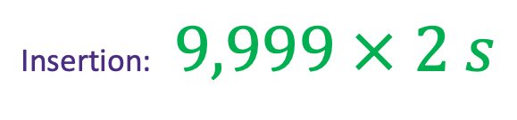
17.2 Insertion
If there are 10,000 users
Each memory ops takes 2 seconds
Search the location: 13.3 seconds
Insertion: $9,999 × 2 s$

Slide 16
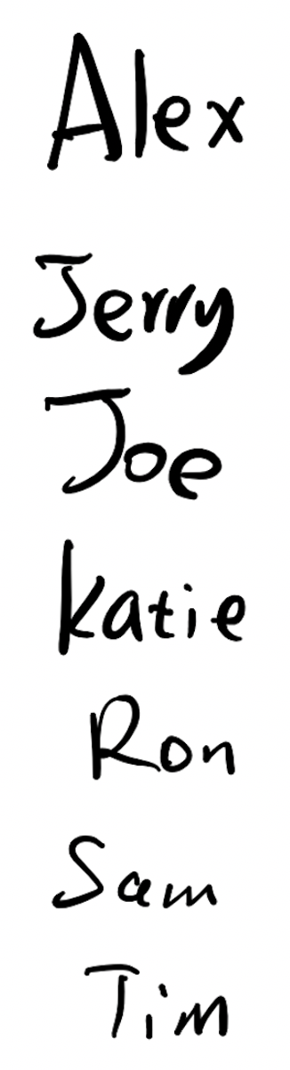


17.2 Insertion
If there are 10,000 users
Each comparison takes 1 seconds
Each memory ops takes 2 seconds
Insertion: $2s$
Search the location: ??

Slide 17
Fast for search
Slow for insertion
Slow for search
Fast for insertion

Slide 18
17.3 Do both fast?

Slide 19
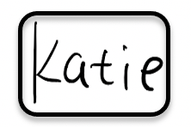
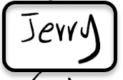
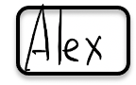
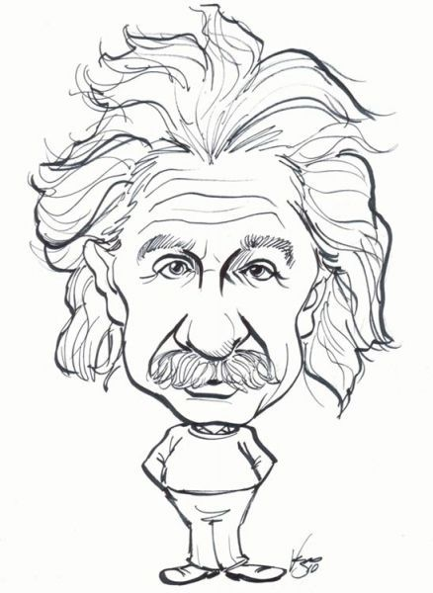





Slide 20
Hash Algorithm

Slide 21
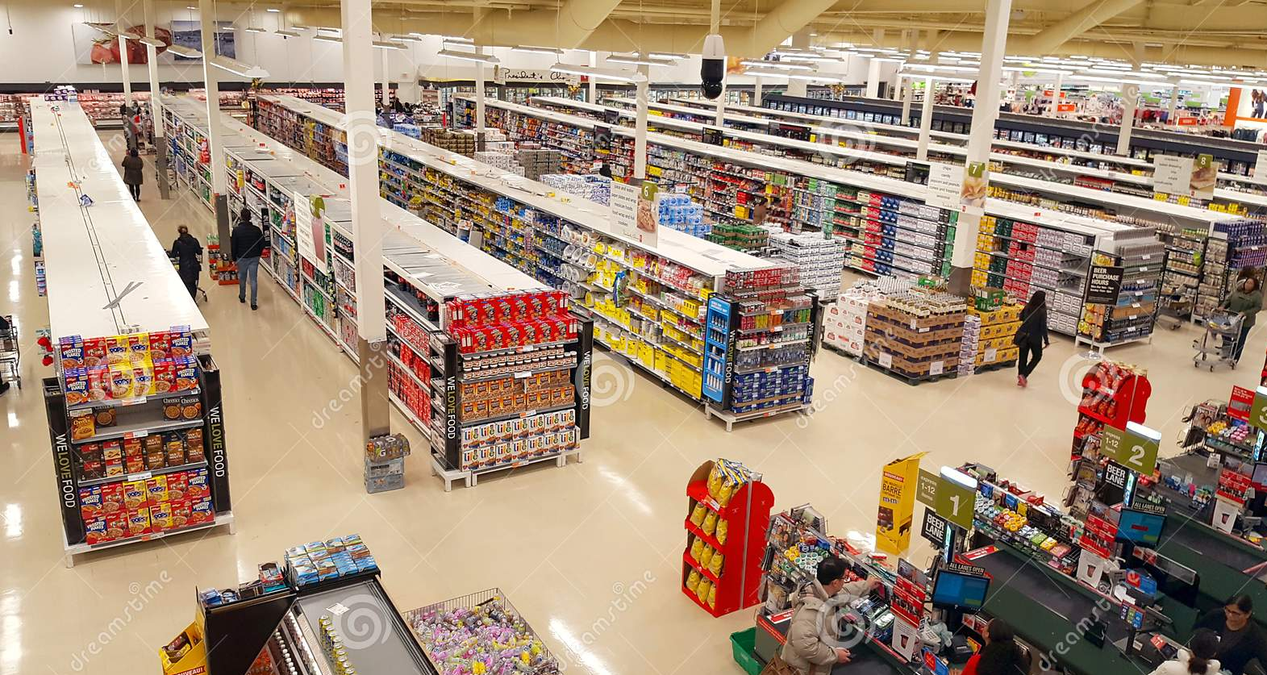
“Where is orange juice?”

Slide 22
0
3
6
7
9
12
13

Slide 23
0
3
6
7
9
12
13

Slide 24

0
3
hashing
6
7
9
12
13
hashing
8

Slide 25
6
value
keyword
“Key value pair”

Slide 26
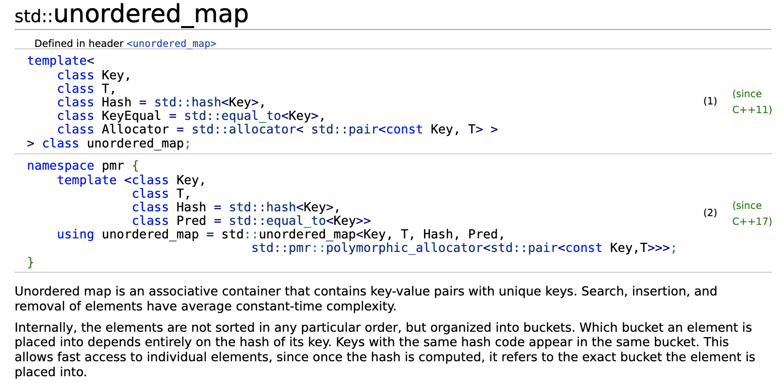
STD::unordered_map
“Internally, the elements are not sorted in any particular order, but organized into buckets. Which bucket an element is placed into depends entirely on the hash of its key. ”

Slide 27
Word Frequency
Give a text of words
You can't handle the truth! Son, we live in a world that has walls, and those walls have to be guarded by men with guns. Who's gonna do it? You? You, Lieutenant Weinberg? I have a greater responsibility than you can possibly fathom. You weep for Santiago and you curse the Marines. You have that luxury. You have the luxury of not knowing what I know, that Santiago's death, while tragic, probably saved lives. And my existence, while grotesque and incomprehensible to you, saves lives! You don't want the truth, because deep down in places you don't talk about at parties, you want me on that wall. You need me on that wall. We use words like "honor", "code", "loyalty". We use these words as the backbone of a life spent defending something. You use them as a punchline. I have neither the time nor the inclination to explain myself to a man who rises and sleeps under the blanket of the very freedom that I provide, and then questions the manner in which I provide it! I would rather you just said "thank you", and went on your way. Otherwise, I suggest you pick up a weapon, and stand a post. Either way, I don't give a damn what you think you are entitled to!
“A Few Good Men” https://www.youtube.com/watch?v=9FnO3igOkOk
Count how many times each word/sentence appears.

Slide 28
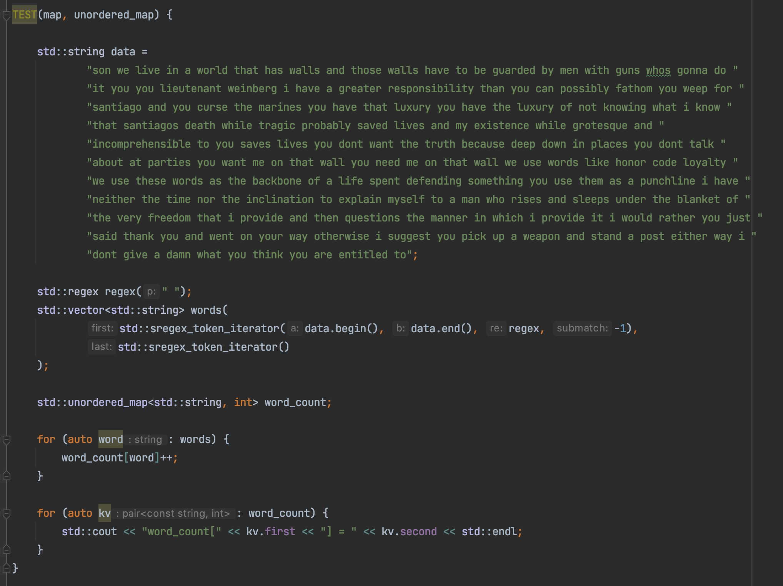
Word Frequency

Slide 29
Hash Algorithm

Slide 30
0
3
hashing
6
7
9
12
13
hashing
8

Slide 31
Key value pair: (K, V)
(K,V)
Hash function
6
Hash key
key K

Slide 32
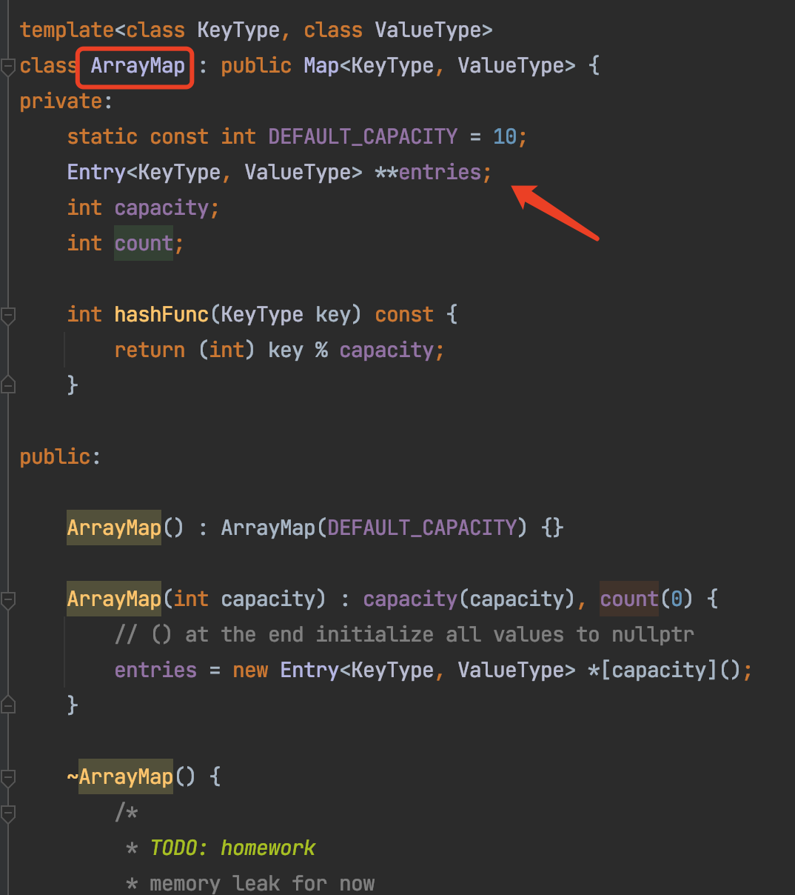
ArrayMap

Slide 33
Hashing
Key x
Index y
“Key”
“Hash Key”
String
Integer

Slide 34
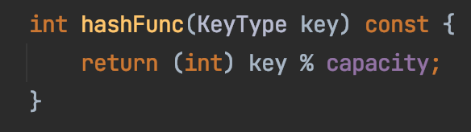
Hashing
Key x
Index y
String
Integer

Slide 35
Collision
collision
key=Sam
key=Ron

Slide 36
Collision
Three approaches
Better hashing algorithm
Find another location in the table
3. Modify the entry to be able to hold more than one set of values
https://medium.com/basecs/hashing-out-hash-functions-ea5dd8beb4dd
“open addressing”

Slide 37
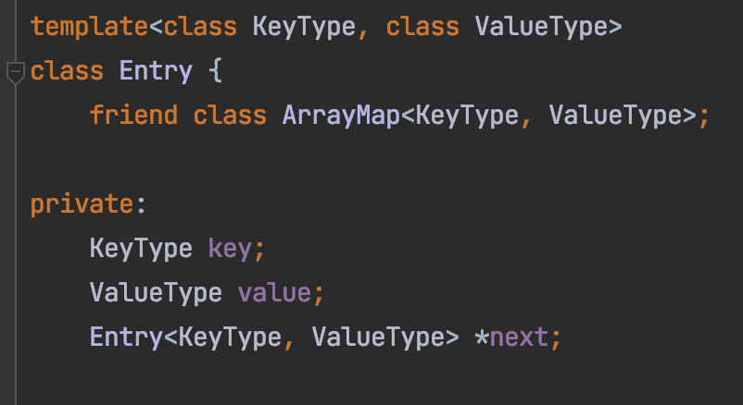
Chaining
Sam
Ron
key=Sam
key=Ron

Slide 38
Chaining
Sam
Ron
Alex
Jerry
Katie
Joe
Tim

Slide 39
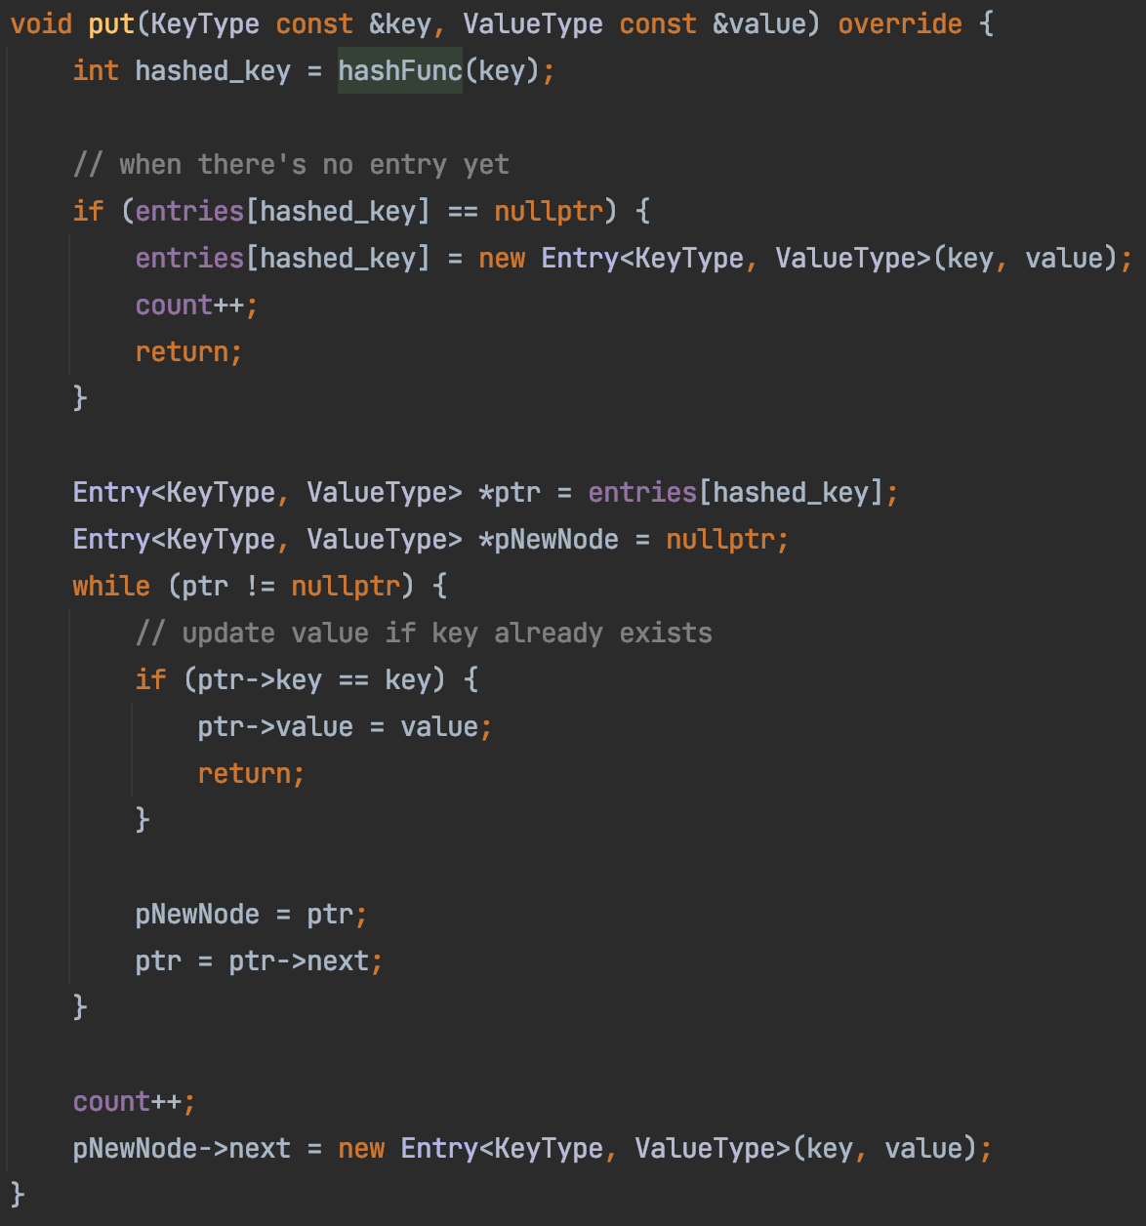
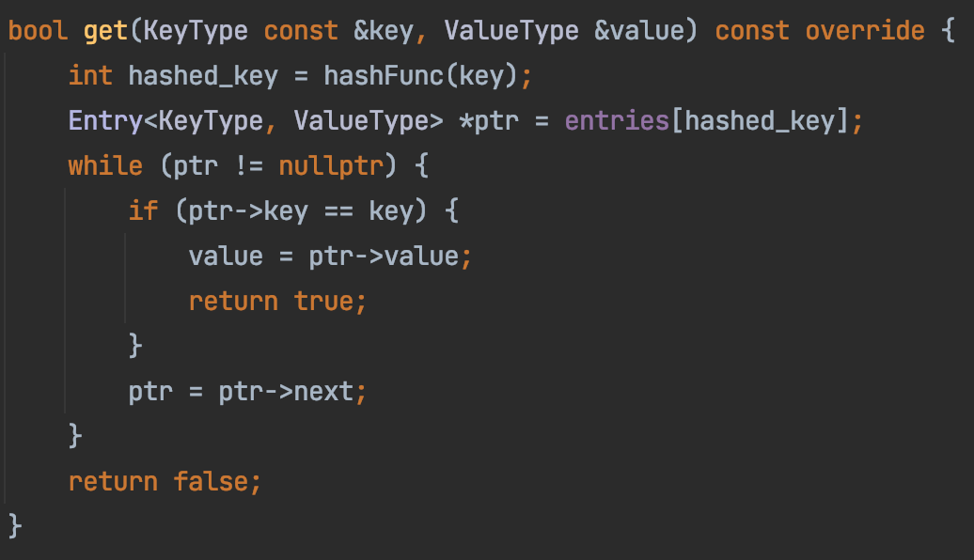
ArrayMap

